Slide 1
Modeling Reality -- an Honors Course
It’s not your grandparents’ universe
Andrew A. Anda, Ph.D.
Assistant Professor of Computer Science
St. Cloud State University
aanda@stcloudstate.edu

Slide 2
Motivations
Computation {modeling & simulation} has emerged as the new third paradigm of science (in addition to experiment & theory)
  Computer simulations are in many cases the only way to connect the advanced theoretical models of today with experimental data.
“Over the years, the practices of systems, modeling, and innovating have taken on peer roles with programming” [1]
[1] Denning, P.J. “Great principles of computing”, CACM 46, 11 (Nov. ’03), 15-20

Slide 3
Learning Objective
The exploration of new scientific world-views which have been emerging through a process of evolution or revolution.
  New reductionism: parts & their interactions.
  Theories of everything, e.g. small world networks & organization, cellular automata, emergent phenomena, chaos & dynamical systems, computability, probability, criticality, information, agents
  Conceptual & computational tools for exploring & exploiting the new theories

Slide 4
Why Honors?
This course:
Challenges the student
Encompasses a great breadth of disciplines
Reveals implications for public policy
Offers opportunities for
  Reflection
  Collaboration
  Discussion
  Research

Slide 5
Student Population
My intention for this course is that each student should have a background in either computing or a discipline that could admit modeling.
Modeling teams are formed, whereby each team comprises both students who can program (OOP), and those who can’t
Those students who can’t program function as domain experts for the models built by the programmers

Slide 6
Resource Media
Texts
Course Web page
D2L {course management system} discussion facility
Course Wiki
Wikipedia
Computer animations & interactive applets
Readings from other sources
Copies of articles from the popular science press, e.g. Science News & Scientific American.

Slide 7
Texts
Modeling Reality
How computers mirror life
by Iwo Bialynicki-Birula and Iwona Bialynicka-Birula
Nexus: Small Worlds and the Groundbreaking Theory of Networks
by: Mark Buchanan
The Computational Beauty of Nature
Computer Explorations of Fractals, Chaos,
Complex Systems, and Adaptation
by Gary William Flake

Slide 8
Classroom Environment
Smart Desk classroom
Workstations for each student
Moveable chairs allowing for group discussion, lecture, or workstation use

Slide 9
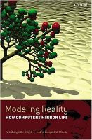

Inspiration
Modeling Reality
How computers mirror life
by Iwo Bialynicki-Birula and Iwona Bialynicka-Birula
Oxford University Press 2004

Slide 10

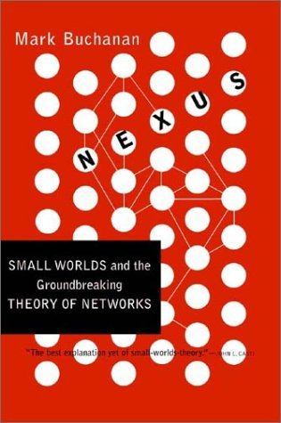
Narrative Secondary Text
Nexus: Small Worlds and the Groundbreaking Theory of Networks
by: Mark Buchanan

Slide 11
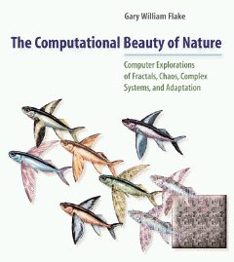

Supplementary Text
The Computational Beauty of Nature
Computer Explorations of Fractals, Chaos,
Complex Systems, and Adaptation
by Gary William Flake
Dealing With Difficult Subjects {excerpt from preface}

Slide 12
Dealing with Difficult Subjects
3rd grade through graduate student difficulty
  This is intentional!
If you’re confused by a sentence, section, or chapter, first see if the glossary helps, if not, move on.
If a picture’s worth 1K words, an equation’s worth 1G. An equation can often describe something so completely and compactly, any other type of description becomes cumbersome by comparison.
But, the equations should be subordinate to the supporting text
The topics covered in this book demand varying amounts of sophistication from you.
continue

Slide 13
Dealing With Difficult Subjects
{continued}
If a particular equation confuses you:
Examine the surrounding text for more insight into what the symbols mean
Look for a picture which illustrates the equation
{if all else fails} Mentally substitute the sounds
“blah blah blah” for the equation and keep going.
Don’t be discouraged if you don’t understand something, or write it off as beyond your capabilities
It may happen that you’ll retroactively understand something, given enough time and effort.

